Slide 1
Virtual Machine Environments for Development and Testing
Could be very good If I was provided with a VM of the company for the building and testing stage.
Benefits:
Security
Availability of the GPU based machines (to facilitate the speed of the LLM).

Slide 2
Structuring Excel Form Data with JSON Format
Structuring data with JSON format.
Human-readable format
Lightweight and Compact
Easy to Parse and Generate
Language Agnostic
meaning it can be easily processed and understood by various programming languages.

Slide 3
RAG Chatbot for Corporate Software Explanation Documents
Challenges faced by the functional analytics team in dealing with large volumes of software explanation documents.
RAG Chatbot as a solution.

Slide 4
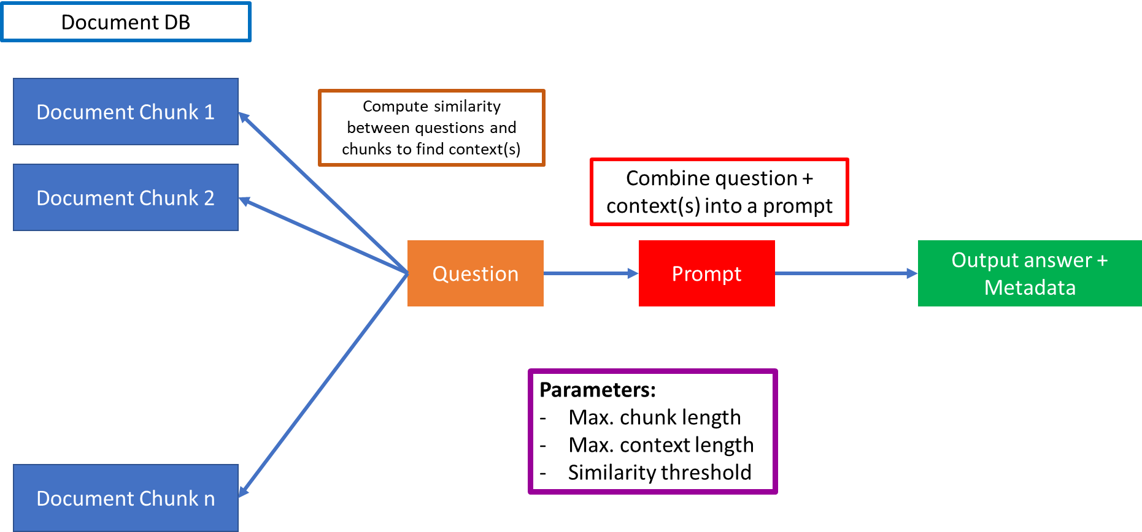

Slide 5
RAG (Retrieval-augmented generation) Chatbot.
Natural Language Processing (NLP): The RAG Chatbot is equipped with advanced NLP capabilities, allowing it to understand and interpret natural language queries and responses from users.
Text Summarization: The chatbot can summarize extensive texts, extracting the most important and relevant information. This feature is particularly useful for condensing lengthy software explanation documents into concise summaries.
Contextual Understanding: The chatbot maintains context throughout the conversation, enabling it to comprehend the nuances of user queries and provide accurate responses based on the information extracted from previous interactions.
Structured Data Extraction: The RAG Chatbot is capable of extracting structured data from unstructured text. This allows the functional analytics team to obtain specific information, such as key metrics or data points, without manually reading through extensive documents.

